Slide 1
Offline handwritng Segmentation
Rahul Dixit – 01fb16eee067
Manik B. sOmayaji – 01fb16eec149

Slide 2
Problem statement
To perform Segmentation of handwritten words into letters using vertical contours method.

Slide 3
introduction
This project presents a robust algorithm to identify the letter boundaries in images of unconstrained handwritten words.
The proposed algorithm is based on vertical contour analysis. It is performed to generate segmentation of words into letters by analysing vertical contours
The Preprocessing methods used to implement the algorithm are Thresholding,Slant correction, shear correction,skeletonisation.

Slide 4
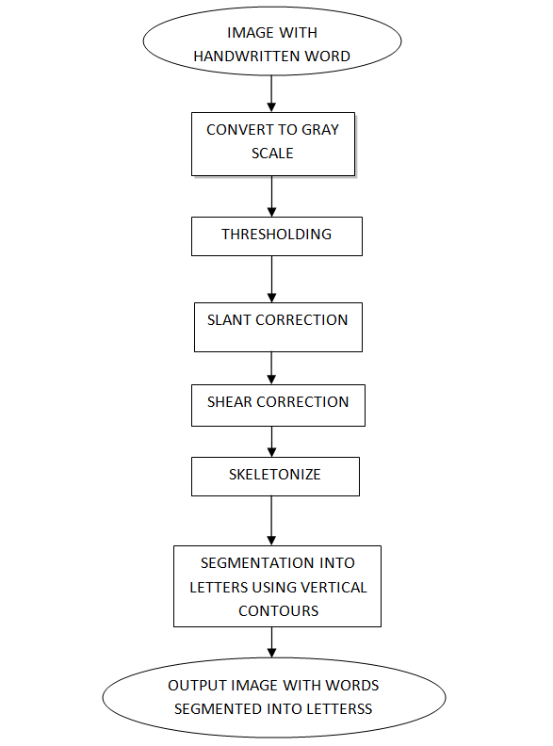
Block diagram

Slide 5
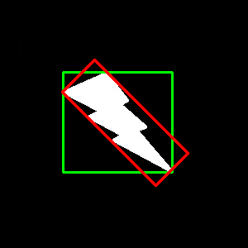
Slant Correction
Slant is one of the characteristics that make handwriting harder to process automatically than printed text. For this reason slant correction is a standard step in systems for processing written text.
In order to achieve this we need to find the angle at which the word is oriented .
The function used is cv2.minAreaRect(). It returns a Box2D structure which contains following details - ( top-left corner(x,y), (width, height), angle of rotation )

Slide 6
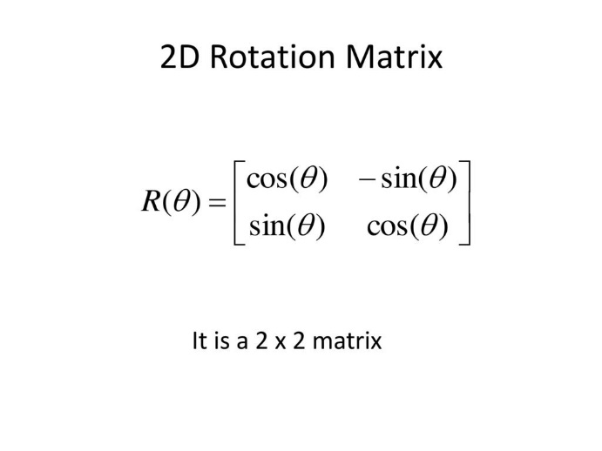
SLANT CORRECTION
Then based on angle we get , we use the rotation matrix to fix its orientation to horizontal.

Slide 7
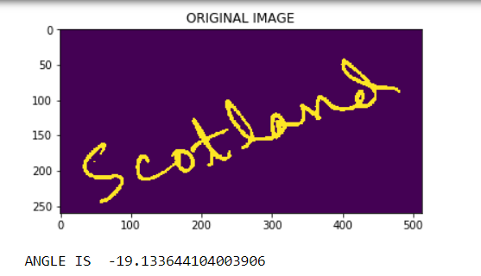
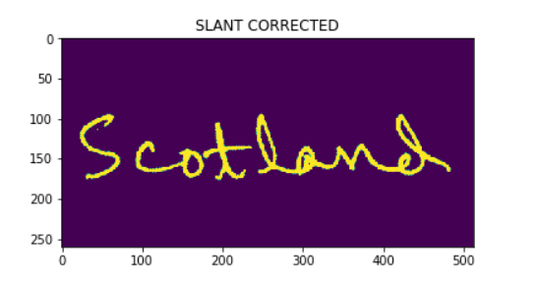
Slant CORRECTION results

Slide 8

Shear correction
In normal handwriting we tend to write each letter in a word at different angles.
For processing purposes we make them as perpendicular as possible in order to make the vertical segmentation step effective.

Slide 9
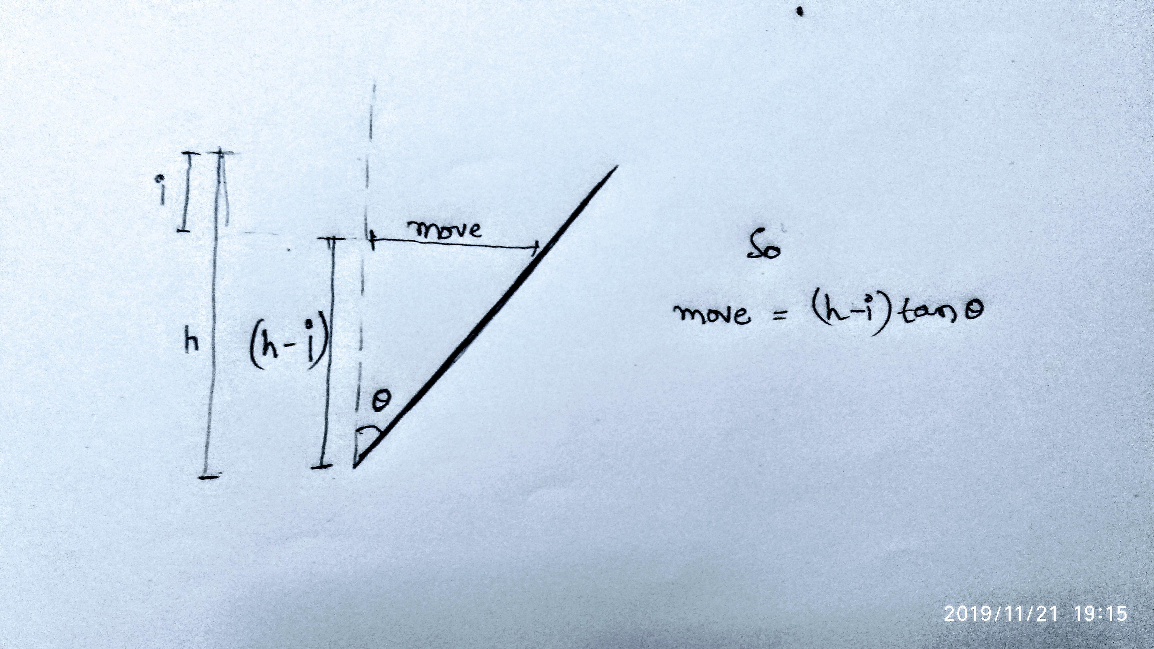
Shear correction
We need to rotate the image with the pivot as its base
We do it the following way
Increment the theta by small angle and rotate the letter
For each rotation by theta, we calculate the column sum.
Choose that theta which maximises the number of columns having sum above some threshold.

Slide 10
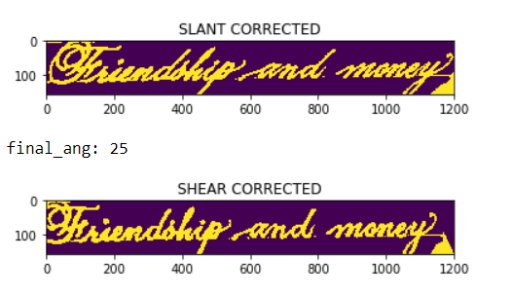
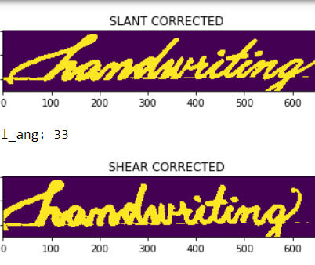
Shear correction result

Slide 11
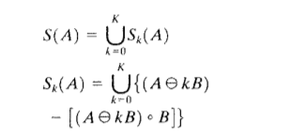
skeletonize
Skeletonization is a process for reducing foreground regions in a binary image to skeletal remnant that largely reserves the extent and connectivity of the original region while throwing away most of the original foreground pixels.

Slide 12
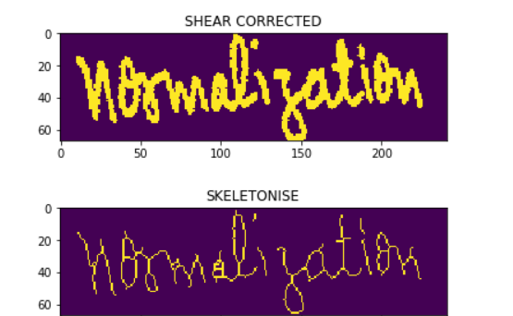
Skeletonization results

Slide 13
Segmentation
In the skeletonised image is taken and we draw vertical boundaries at the start and end of each letter
In order to determine where those boundaries fall we count the number of pixels at each column of the image.
Wherever the count is 0 or 1 , that is considered as a potential boundary.

Slide 14
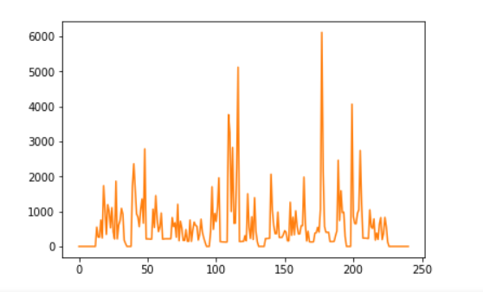
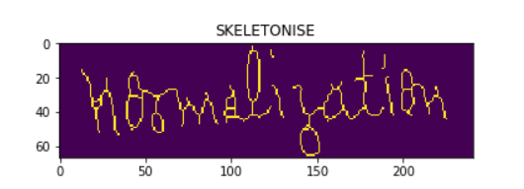
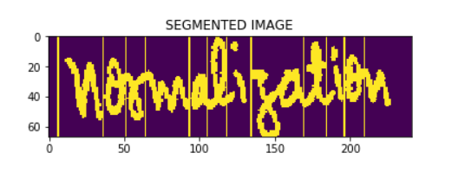
Segmentaion results

Slide 15
Results and conclusion
Here, the approach for off-line cursive handwriting segmentation has been described and a segmentation system incorporating the proposed approach has been built to perform segmentation on postal address images.
The experimental results obtained by the segmentation system on postal address images show that the proposed approach is capable of locating the letter boundaries in cursive words.
Obviously, there could be number of errors occurring in the segmentation, most of which can be eliminated if we use Machine Learning .

Slide 16
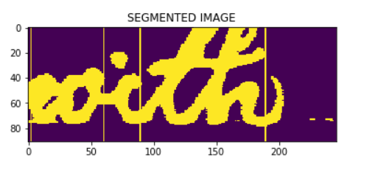
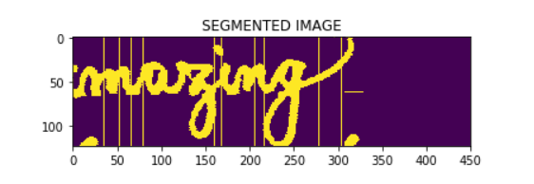
RESULTS AND CONCLUSION

Slide 17

Applications and future development
Used in OCR(Optical Character Recognition )
Can be used for online handwriting recognition for notes taking software
Used in digitalising the old documents
njnnjnj

